Slide 1

Smart Health Enquiry
Neena Thomas
B6GMCA2114
Don Bosco College
Angadikadavu
Kannur

Slide 2
INTRODUCTION
The smart health enquiry is an android application that helps users to submit their problem about health.
The users can ask any questions or query related to that disease without physically available to the hospitals.

Slide 3
SYSTEM ANALYSIS

Slide 4
REQUIREMENT GATHERING
Questionnaire
Interview
Site Visit
Website visit

Slide 5
Apps
Gyant
Cancer chatbot
Your.md
Infermedica

Slide 6
Existing System
In existing system, if the patients having any symptoms or disease they want to go to a hospital and consult a doctor.
Sometimes people are interested in self treatment.

Slide 7
Problem with existing system
People are not always ready with consulting a doctor.
People are not aware of symptoms and treatment
Sometimes the consulting doctor may not be the right doctor for patient.

Slide 8
Time consuming to consult with right doctor.
People are not aware of all hospitals and doctors.

Slide 9
Proposed System
The smart health enquiry is an android application that helps users to submit their problem about health.
users report the symptoms of their illness to the app, which checks them against a database of diseases using speech recognition, and then offers an appropriate course of action.

Slide 10
Advantages of proposed system
Get the details about the disease without physically available to the hospitals.
Get information about all hospitals and doctors .
Get information for caregivers to ease the burden of caring.

Slide 11
Feasibility study
Economic Feasibility
Technical Feasibility
Behavioral Feasibility
Legal Feasibility

Slide 12
Identification of actor
1 | Who will use the main functionality of the system? | Administrator, User
2 | Who will lead support from the system and do their daily tasks? | User
3 | Who will maintain and administrate the system? | Administrator
4 | With which other systems, does this system need to interact? | Database
5 | Who was interest in the result produced by the system? | Administrator, User

Slide 13
Mainly Two actors are there
Admin
User

Slide 14
Use case diagram

Slide 15
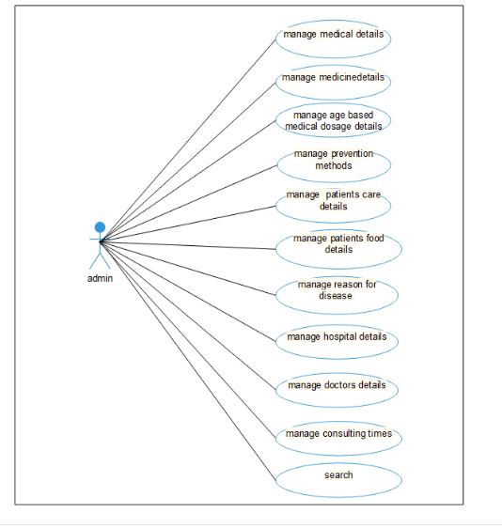

Slide 16
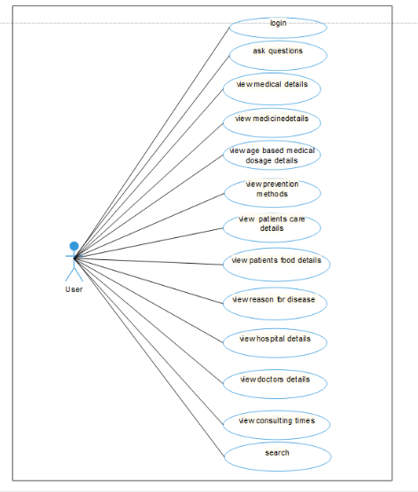
User

Slide 17
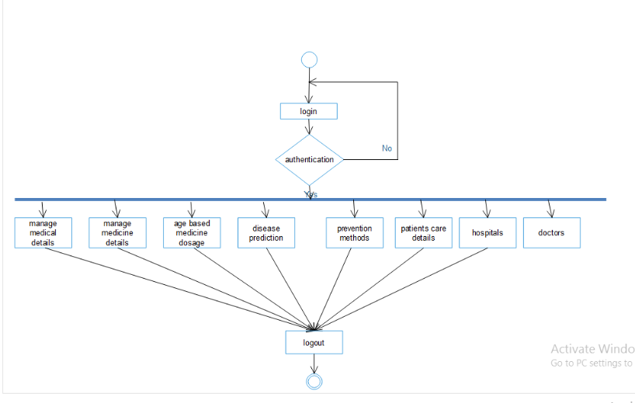
Activity Diagram

Slide 18
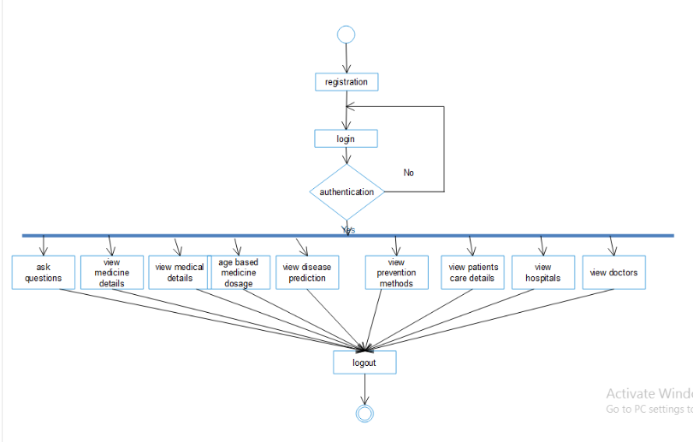

Slide 19
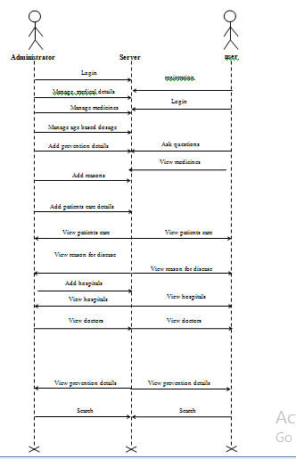
Sequence diagram

Slide 20
Processor : Pentium or higher version (32bit/64bit) Processor
RAM : 1GB and Above
Keyboard : Standard Keyboard with 104 keys
Mouse : Standard Mouse with 3 buttons
Monitor : Display Panel (1366*768)

Slide 21
Software requirement
Programming Language : c#, java
DBMS : sql server 2014
Software’s used : Microsoft visual Studio 2013
Operating System : Windows 8
Platform : Android

Slide 22
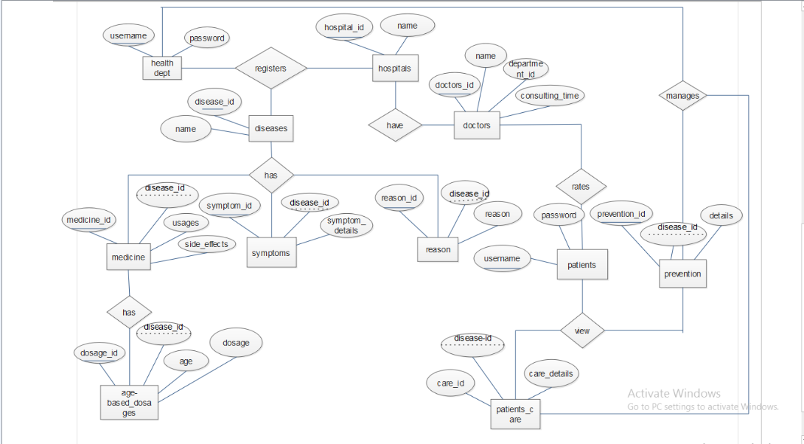
ER Diagaram

